Slide 1

Digital Speech Processing
數位語音處理概論
第一講 Introduction to Digital Speech Processing
授課教師：國立臺灣大學 電機工程學系 李琳山 教授
【本著作除另有註明外，採取創用CC「姓名標示－非商業性－相同方式分享」台灣3.0版授權釋出】

Slide 2
Speech Signal Processing
Major Application Areas
Speech Coding:Digitization and Compression
Considerations : 1) bit rate (bps)
2) recovered quality
3) computation
complexity/feasibility
Voice-based Network Access —
User Interface, Content Analysis, User-content Interaction
x(t)
x[n]
LPF
Processing Algorithms
output
Speech Signals
Carrying Linguistic Knowledge and Human Information: Characters, Words, Phrases, Sentences, Concepts, etc.
Double Levels of Information: Acoustic Signal Level/Symbolic or Linguistic Level
Processing and Interaction of the Double-level Information
x[n]
^
Processing
x_{k}
110101…
Inverse Processing
x[n]
Storage/transmission

Slide 3
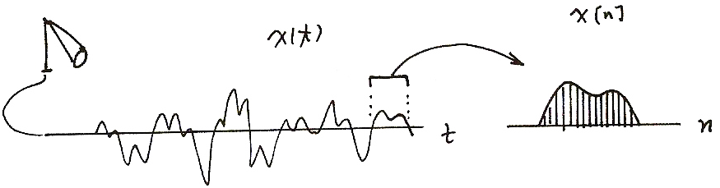
Sampling of Signals
X[n]
X(t)
t
n

Slide 4
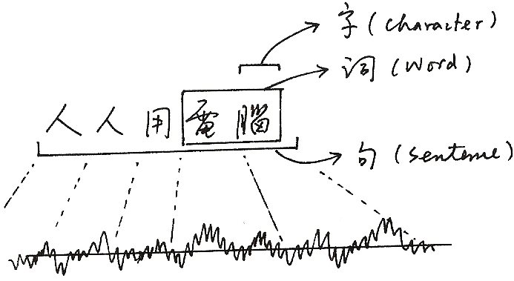
Double Levels of Information
字(Character)
詞(Word)
人人用電腦
電腦
句(Sentence)

Slide 5




Speech Signal Processing – Processing of Double-Level Information
Speech Signal
Sampling
Processing
今 天 的
Algorithm
天 氣 非
Chips or Computers
Linguistic Structure
常 好
Linguistic Knowledge
今天的 天氣
非常 好
Lexicon
Grammar
今天 的

Slide 6
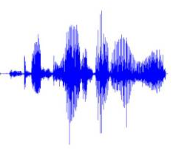
Well-Known Application Examples of Speech and Language Technologies – Speaking Personal Assistant
Examples
Weather in New York next week ?
Who is the president of US ? What did he say today ?
How can I go to National Taiwan University ?
Short messaging, personal scheduling, etc.
Special Questions:
唐詩宋詞, 出師表…
說個笑話…
Speech
Synthesis
Language
Generation
Output Speech
Signals
Speech
Recognition
Language
Understanding
Dialogue
Manager
Input Speech
Signals
Information
Retrieval
Knowledge
Graph
Question
Answering
Machine
Translation
Wikipedia
Examples:
Siri (Apple), Google Now (Google), Cortana (Microsoft)

Slide 7
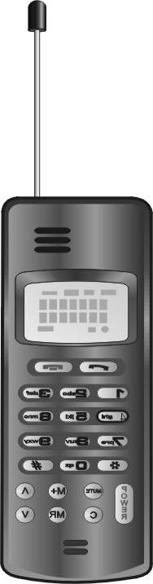

Voice-based Network Access
Internet
User Interface
Content Analysis
User-Content Interaction
User Interface
—when keyboards/mice inadequate
Content Analysis
— help in browsing/retrieval of multimedia content
User-Content Interaction
—all text-based interaction can be accomplished by spoken language

Slide 8
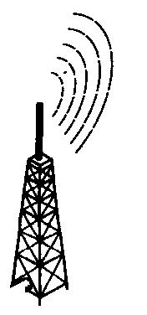
User Interface —Wireless Communications Technologies have Created a Whole Variety of User Terminals
Text Content
Internet
Multimedia Content
at Any Time, from Anywhere
Smart phones, Hand-held Devices, Notebooks, Vehicular Electronics, Hands-free Interfaces, Home Appliances, Wearable Devices…
Small in Size, Light in Weight, Ubiquitous, Invisible…
Post-PC Era
Keyboard/Mouse Most Convenient for PC’s not Convenient any longer
— human fingers never shrink, and application environment is changed
Service Requirements Growing Exponentially
Voice is the Only Interface Convenient for ALL User Terminals at Any Time, from Anywhere, and to the point in one utterance
Speech Processing is the only less mature part in the Technology Chain

Slide 9
Content Analysis—Multimedia Technologies have Created a World of Multimedia Content
Internet
Real–time
Information
weather, traffic
flight schedule
stock price
sports scores
Private Services
personal notebook
business databases
home appliances
network
entertainments
Intelligent Working
Environment
e–mail processors
intelligent agents
teleconferencing
distant learning
electric commerce
Knowledge
Archieves
digital libraries
virtual museums
Special Services
Google
FaceBook
YouTube
Amazon
Most Attractive Form of the Network Content is Multimedia, which usually Includes Speech Information (but Probably not Text)
Multimedia Content Difficult to be Summarized and Shown on the Screen, thus Difficult to Browse
The Speech Information, if Included, usually Tells the Subjects, Topics and Concepts of the Multimedia Content, thus Becomes the Key for Browsing and Retrieval
Multimedia Content Analysis based on Speech Information

Slide 10

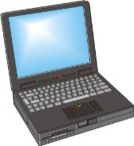
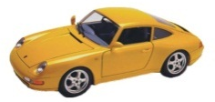
User-Content Interaction — Wireless and Multimedia Technologies are Creating An Era of Network Access by Spoken Language Processing
text
information
Text-to-Speech Synthesis
Multimedia Content
Text Content
voice information
Spoken and multi-modal Dialogue
Voice-based Information Retrieval
Internet
voice input/ output
Multimedia Content Analysis
Text Information Retrieval
Hand-held Devices with Multimedia Functionalities Commonly used Today
Network Access is Primarily Text-based today, but almost all Roles of Texts can be Accomplished by Speech
User-Content Interaction can be Accomplished by Spoken and Multi-modal Dialogues
Using Speech Instructions to Access Multimedia Content whose Key Concepts Specified by Speech Information

Slide 11
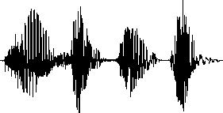

Voice-based Information Retrieval
Voice Instructions
Text Instructions
請問鼎泰豐的地址？
Text Information
Voice Information
d1
d1
d2
d2
d3
d3
鼎泰豐台北101分店在…
Both the User Instructions and Network Content Can be in form of Speech

Slide 12
Spoken and Multi-modal Dialogues
Almost All User-Content Interaction can be Accomplished by Spoken or Multi-modal Dialogues
Sentence Generation
and Speech Synthesis
Internet
Users
Output Speech
Response to the user
Discourse Context
Dialogue
Manager
Databases
Wireless Networks
User’s Intention
Input Speech
Dialogue Server
Speech Recognition and Understanding

Slide 13
Outline
Both Theoretical Issues and Practical Problems will be Discussed
Starting with Fundamentals, but Entering Research Topics in the Second Half
Part I: Fundamental Topics
1.0 Introduction to Digital Speech Processing
2.0 Fundamentals of Speech Recognition
3.0 Map of Subject Areas
4.0 More about Hidden Markov Models
5.0 Acoustic Modeling
6.0 Language Modeling
7.0 Speech Signals and Front-end Processing
8.0 Search Algorithms for Speech Recognition
Part II: Advanced Topics
9.0 Speech Recognition Updates
10.0 Speech-based Information Retrieval
11.0 Spoken Document Understanding and Organization for User-content Interaction
12.0 Computer-assisted Language Learning(Call)
13.0 Speaker Variabilities: Adaption and Recognition
14.0 Latent Topic Analysis
15.0 Robustness for Acoustic Environment
16.0 Some Fundamental Problem-solving Approaches
17.0 Spoken Dialogues
18.0 Conclusion

Slide 14
References
教科書：無
主要參考書：
X. Huang, A. Acero, H. Hon, “Spoken Language Processing”, Prentice Hall, 2001,松瑞
F. Jelinek, “Statistical Methods for Speech Recognition”, MIT Press, 1999
L. Rabiner, B.H. Juang, “Fundamentals of Speech Recognition”, Prentice Hall, 1993, 民全
C. Becchetti, L. Prina Ricotti, “Speech Recognition- Theory and C++ implementation”, Johy Wiley and Sons, 1999, 民全
D. Jurafsky, J. Martin, “Speech and Language Processing- An Introduction to Natural Language Processing, Speech Recognition, and Computational Linguistics, 2nd edition”, Prentice-Hall, 2009
G. Tur, R. De Mori, “Spoken Language Understanding- Systems for Extracting Semantic Information from Speech”, John Wiley & Sons, 2011
其他參考文獻課堂上提供

Slide 15
Other Information
教材：
available on web before the day of class (http://speech.ee.ntu.edu.tw)
適合年級：三、四（電機系、資工系）
成績評量方式
Midterm Exam 25%
Homeworks (I) (II) (Ⅲ) 15%、5%、15％
Final Exam 10%
Term Project 30%

Slide 16
Goals
課程目的：
提供同學進入此一充滿機會與挑戰的新領域所需的基本知識，體驗數學模型與軟體程式如何相輔相成，學習進入一個新領域由基礎進入研究的歷程，體會吸收非結構性知識(Unstructured Knowledge)的經驗
Unstructured Knowledge
Math & Programming
A
B
C
Mathematical
Models
Programming
D
Hardware

Slide 17
1.0 Introduction — A Brief Summary of Core Technologies and Example Application Seenarios
References for 1.0
1.“Speech and Language Processing over the Web”, IEEE Signal Processing Magazine, May 2008

Slide 18
Speech Recognition as a pattern recognition problem
X
W
x(t)
Feature Extraction
Pattern Matching
Decision Making
unknown speech signal
output word
feature vector sequence
y(t)
Y
Reference Patterns
Feature Extraction
training speech

Slide 19
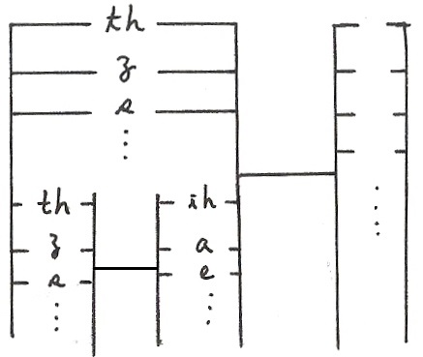
Basic Approach for Large Vocabulary Speech Recognition
A Simplified Block Diagram
Example Input Sentence
this is speech
Acoustic Models (聲學模型)
(th-ih-s-ih-z-s-p-ih-ch)
Lexicon (th-ih-s) → this
(ih-z) → is
(s-p-iy-ch) → speech
Language Model (語言模型) (this) – (is) – (speech)
P(this) P(is | this) P(speech | this is)
P(w_{i}|w_{i-1}) bi-gram language model
P(w_{i}|w_{i-1},w_{i-2}) tri-gram language model,etc
Input Speech
Front-end
Signal Processing
Feature
Vectors
Linguistic Decoding
and
Search Algorithm
Output
Sentence
Speech
Corpora
Acoustic
Model
Training
Acoustic
Models
Language
Model
Language
Model
Construction
Text
Corpora
Lexicon

Slide 20
Speech Recognition Technologies, Applications and Problems
Word Recognition
voice command/instructions
Keyword Spotting
identifying the keywords out of a pre-defined keyword set from input voice utterances
Large Vocabulary Continuous Speech Recognition
entering longer texts
remote dictation/automatic transcription
Speaker Dependent/Independent/Adaptive
Acoustic Reception/Background Noise/Channel Distortion
Read/Spontaneous/Conversational Speech

Slide 21
Text-to-speech Synthesis
Transforming any input text into corresponding speech signals
E-mail/Web page reading
Prosodic modeling
Basic voice units/rule-based, non-uniform units/corpus-based, model-based
Lexicon and Rules
Prosodic Model
Voice Unit Database
Output Speech Signal
Input Text
Text Analysis and Letter-to-sound Conversion
Prosody Generation
Signal
Processing
and
Concatenation

Slide 22
Speech Understanding
Understanding Speaker’s Intention rather than Transcribing into Word Strings
Limited Domains/Finite Tasks
acoustic models
phrase lexicon
concept set
phrase/concept language model
input utterance
phrase graph
understanding results
Syllable Recognition
syllable lattice
Key Phrase Matching
Semantic Decoding
concept graph
An Example
utterance: 請幫我查一下 台灣銀行 的 電話號碼 是幾號?
key phrases: (查一下) - ( 台灣銀行) - (電話號碼)
concept: (inquiry) - (target) - (phone number)

Slide 23
Speaker Verification
Verifying the speaker as claimed
Applications requiring verification
Text dependent/independent
Integrated with other verification schemes
input speech
Feature Extraction
Verification
yes/no
Speaker Models

Slide 24
Voice-based Information Retrieval
Speech Instructions
Speech Documents (or Multi-media Documents including Speech Information)
speech instruction
text instruction
請問鼎泰豐的地址？
text documents
speech documents
d1
d1
d2
d2
d3
d3
鼎泰豐台北101分店在…
Locate exactly the desired utterances
Text descriptions not needed for indexing/retrieving puporses

Slide 25
Spoken Dialogue Systems
Almost all human-network interactions can be accomplished by spoken dialogue
Speech understanding, speech synthesis, dialogue management
System/user/mixed initiatives
Reliability/efficiency, dialogue modeling/flow control
Transaction success rate/average number of dialogue turns
Sentence Generation
and Speech Synthesis
Internet
Users
Output Speech
Response to the user
Discourse Context
Dialogue
Manager
Databases
Networks
User’s Intention
Input Speech
Dialogue Server
Speech Recognition and Understanding

Slide 26
Spoken Document Understanding and Organization
Unlike the Written Documents which are easily shown on the screen for user to browse and select, Spoken Documents are just Audio Signals
— the user can’t listen each one from the beginning to the end during browsing
— better approaches for understanding/organization of spoken documents becomes
necessary
Spoken Document Segmentation
— automatically segmenting a spoken document into short paragraphs, each with
a central topic
Spoken Document Summarization
— automatically generating a summary (in text or speech form) for each short
paragraph
Title Generation for Spoken Documents
— automatically generating a title (in text or speech form) for each short paragraph
Key Term Extraction and Key Term Graph Construction for Spoken Documents
— automatically extracting a set of key terms for each spoken document, and
constructing key term graphs for a collection of spoken documents
Semantic Structuring of Spoken Documents
— construction of semantic structure of spoken documents into graphical hierarchies

Slide 27
Multi-lingual Functionalities
Code-Switching Problem
English words/phrases inserted in spoken Chinese sentences as an example
人人都用Computers，家家都上Internet
OK不OK？OK啦!
the whole sentence switched from Chinese to English as an example
準備好了嗎？Let’s go!
Cross-language Information Processing
globalized network with multi-lingual content/users
cross-language network information processing with a certain input language
Dialects/Accents
hundreds of Chinese dialects as an example
code-switching problem─ Chinese dialects mixed with Mandarin (or plus English) as an example
Mandarin with a variety of strong accents as an example
Global/Local Languages
Language Dependent/Independent Technologies
Code-Switching Speech Processing, Speech-to-speech Translation, Computer-assisted Language Learning

Slide 28
Computer-Assisted Language Learning
Globalized World
every one needs to learn one or more languages in addition to the native language
Language Learning
one-to-one tutoring most effective but with high cost
Computers not as good as Human Tutors
software reproduced easily
used repeatedly any time, anywhere
never get tired or bored
Learning of
pronunciation, vocabulary, grammar, sentences, dialogues, etc.
sometimes in form of games

Slide 29
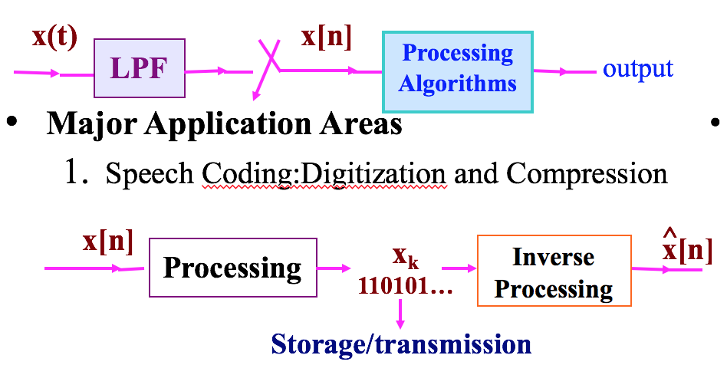
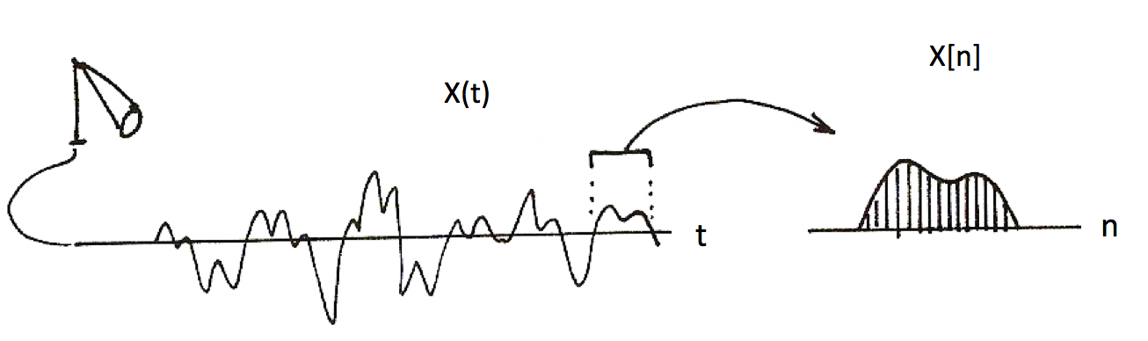
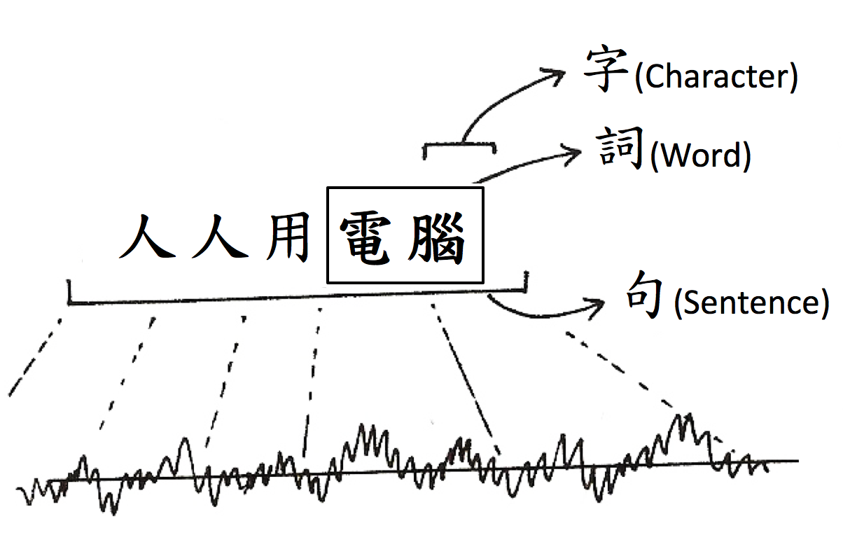
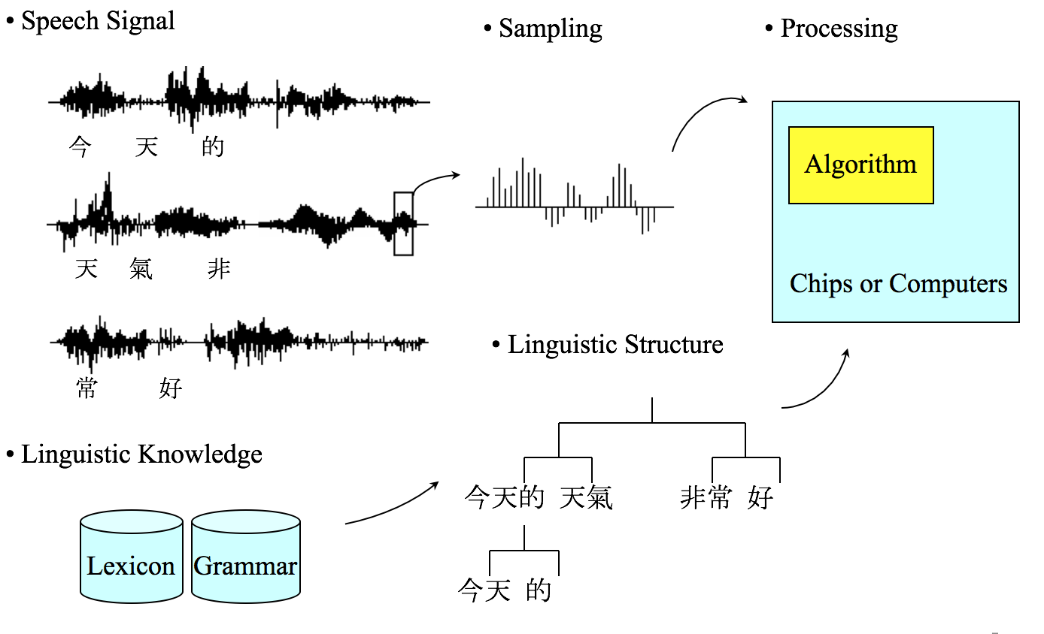
版權聲明
頁碼 | 作品 | 版權標示 | 作者 / 來源
2 |  |  | 國立臺灣大學電機工程學系李琳山 教授。 本作品採用創用CC「姓名標示-非商業性-相同方式分享3.0臺灣」許可協議。
3 |  |  | 國立臺灣大學電機工程學系李琳山 教授。 本作品採用創用CC「姓名標示-非商業性-相同方式分享3.0臺灣」許可協議。
4 |  |  | 國立臺灣大學電機工程學系李琳山 教授。 本作品採用創用CC「姓名標示-非商業性-相同方式分享3.0臺灣」許可協議。
5 |  |  | 國立臺灣大學電機工程學系李琳山 教授。 本作品採用創用CC「姓名標示-非商業性-相同方式分享3.0臺灣」許可協議。

Slide 30
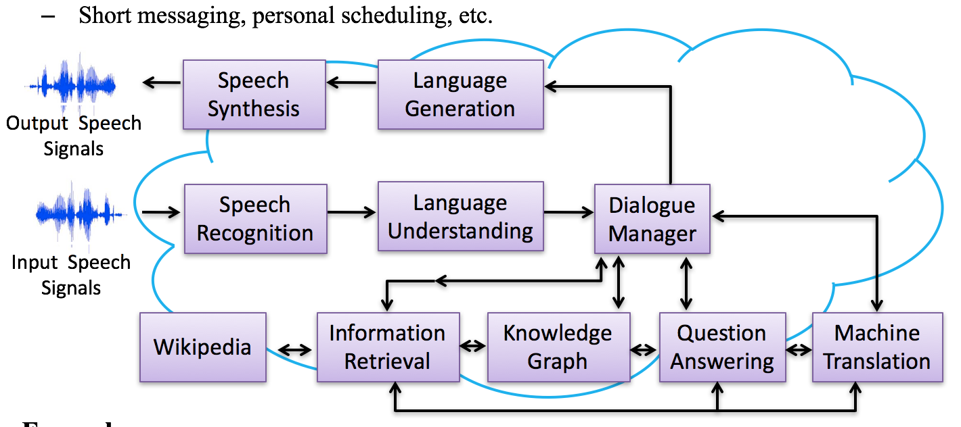
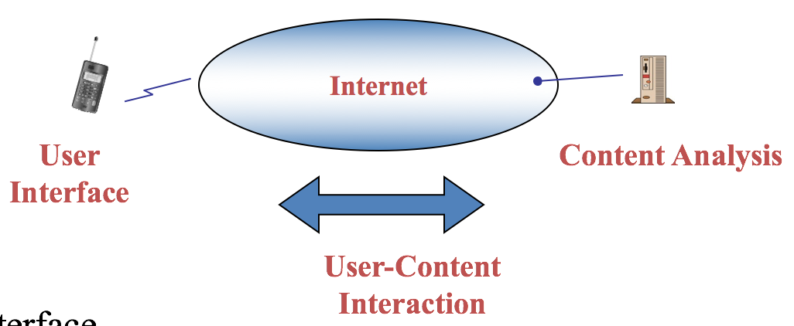
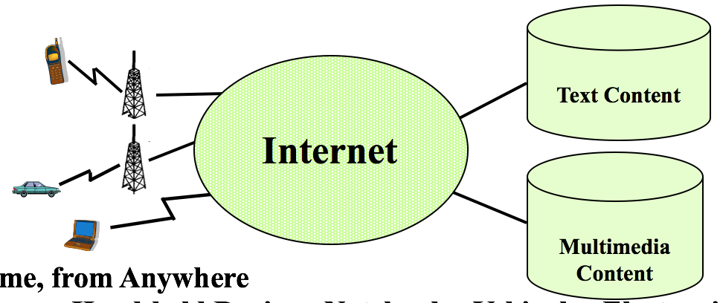
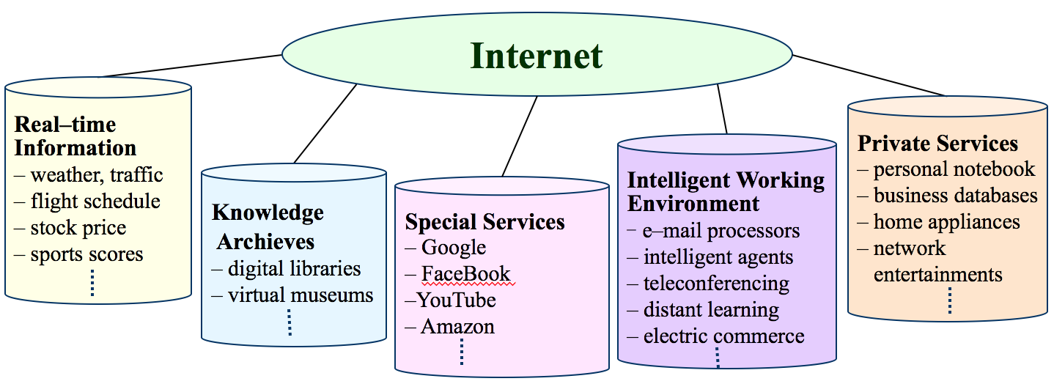
版權聲明
頁碼 | 作品 | 版權標示 | 作者 / 來源
6 |  |  | 國立臺灣大學電機工程學系李琳山 教授。 本作品採用創用CC「姓名標示-非商業性-相同方式分享3.0臺灣」許可協議。
7 |  |  | 國立臺灣大學電機工程學系李琳山 教授。 本作品採用創用CC「姓名標示-非商業性-相同方式分享3.0臺灣」許可協議。
8 |  |  | 國立臺灣大學電機工程學系李琳山 教授。 本作品採用創用CC「姓名標示-非商業性-相同方式分享3.0臺灣」許可協議。
9 |  |  | 國立臺灣大學電機工程學系李琳山 教授。 本作品採用創用CC「姓名標示-非商業性-相同方式分享3.0臺灣」許可協議。

Slide 31
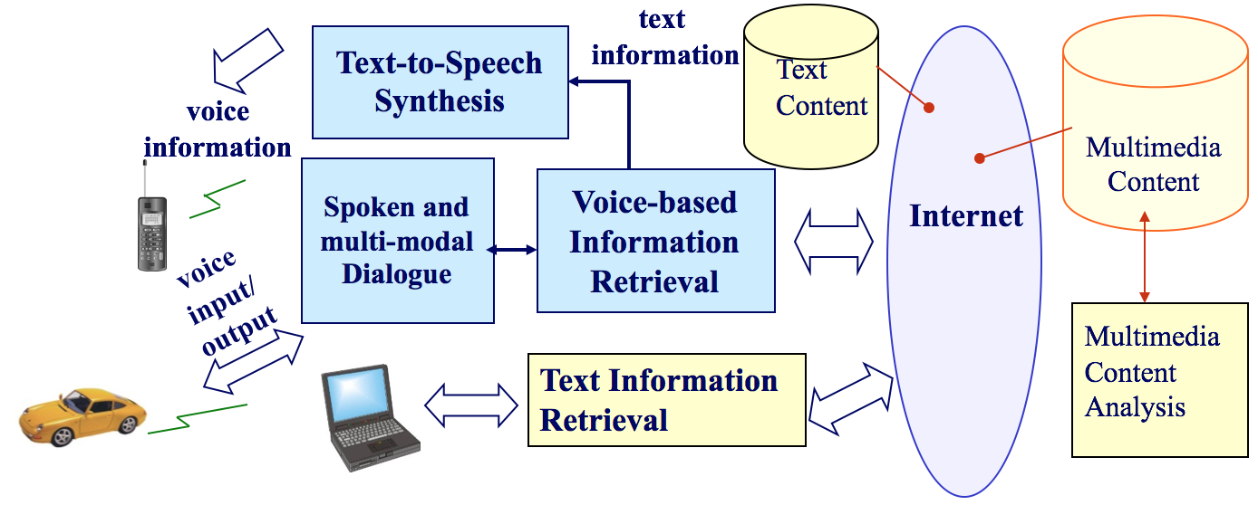
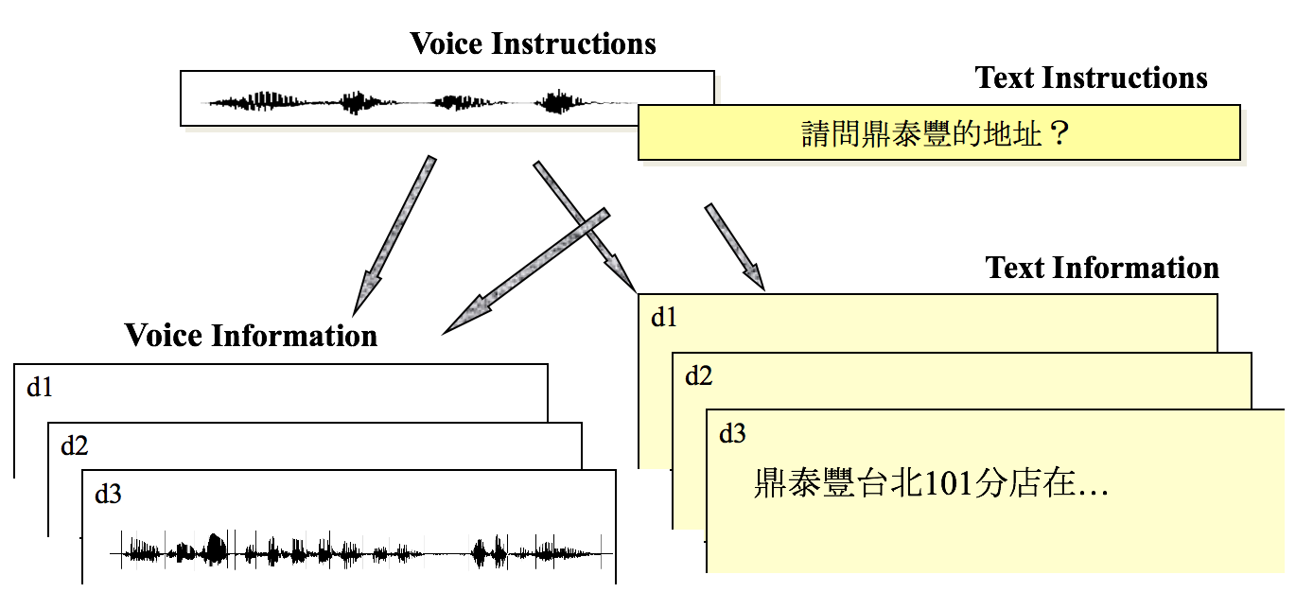
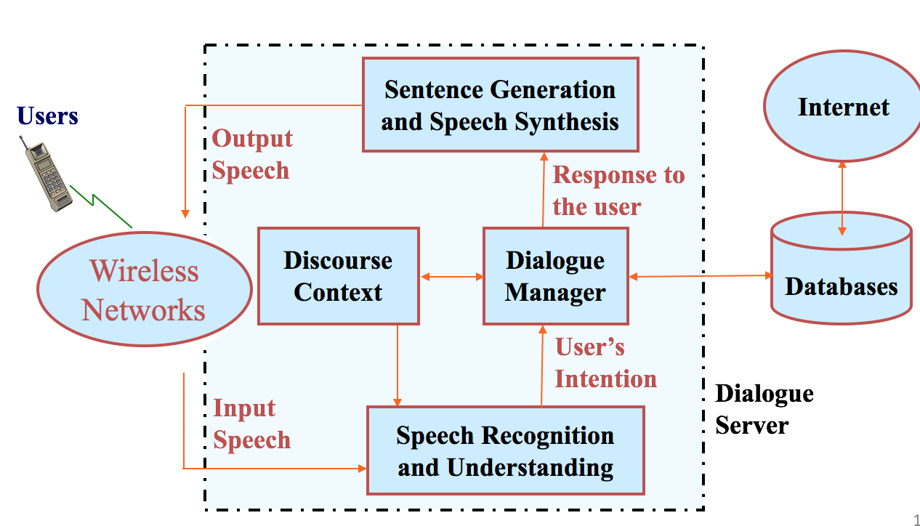
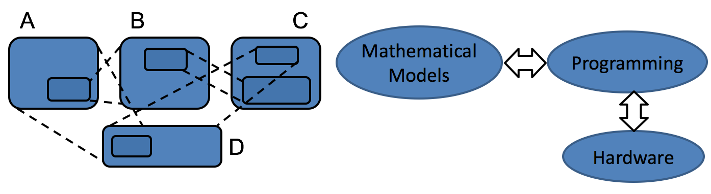
版權聲明
頁碼 | 作品 | 版權標示 | 作者 / 來源
10 |  |  | 國立臺灣大學電機工程學系李琳山 教授。 本作品採用創用CC「姓名標示-非商業性-相同方式分享3.0臺灣」許可協議。
11 24 |  |  | 國立臺灣大學電機工程學系李琳山 教授。 本作品採用創用CC「姓名標示-非商業性-相同方式分享3.0臺灣」許可協議。
12 |  |  | 國立臺灣大學電機工程學系李琳山 教授。 本作品採用創用CC「姓名標示-非商業性-相同方式分享3.0臺灣」許可協議。
16 |  |  | 國立臺灣大學電機工程學系李琳山 教授。 本作品採用創用CC「姓名標示-非商業性-相同方式分享3.0臺灣」許可協議。

Slide 32
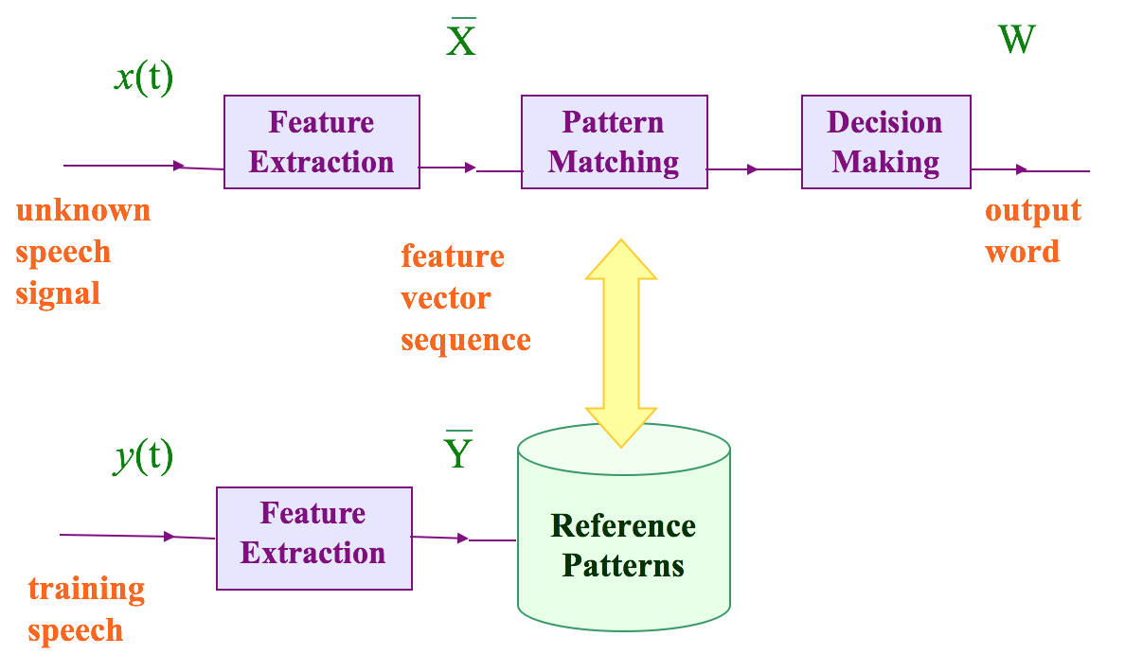
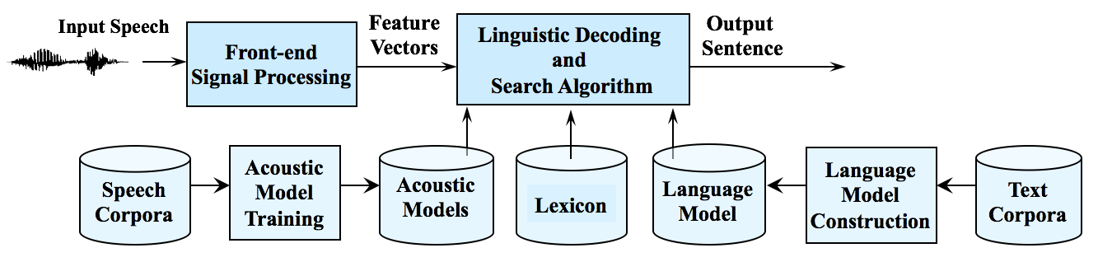
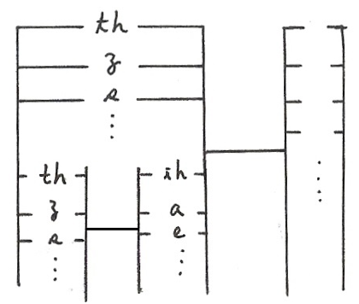
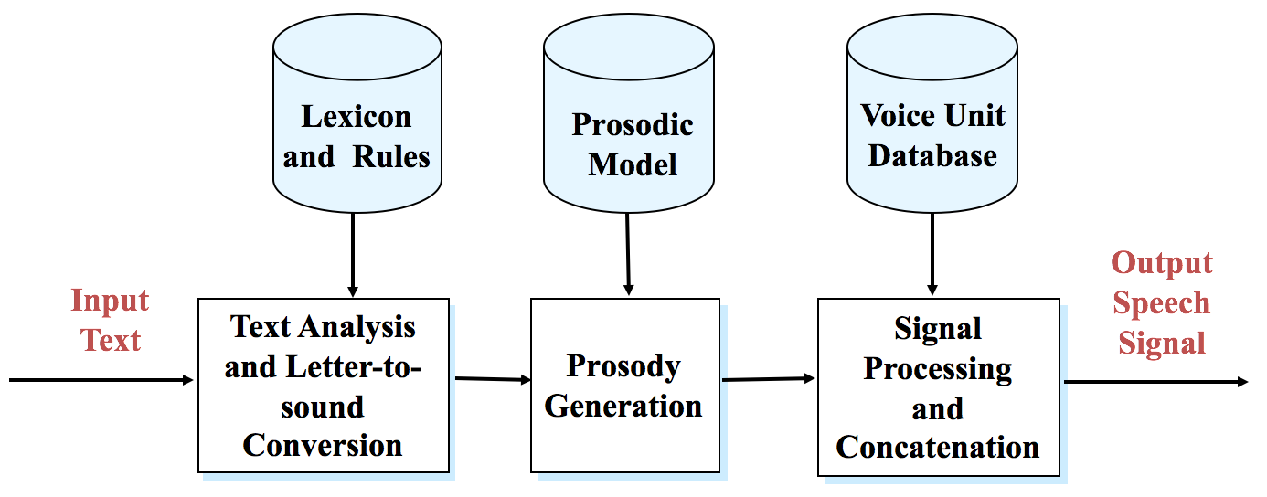
版權聲明
頁碼 | 作品 | 版權標示 | 作者 / 來源
18 |  |  | 國立臺灣大學電機工程學系李琳山 教授。 本作品採用創用CC「姓名標示-非商業性-相同方式分享3.0臺灣」許可協議。
19 |  |  | 國立臺灣大學電機工程學系李琳山 教授。 本作品採用創用CC「姓名標示-非商業性-相同方式分享3.0臺灣」許可協議。
19 |  |  | 國立臺灣大學電機工程學系李琳山 教授。 本作品採用創用CC「姓名標示-非商業性-相同方式分享3.0臺灣」許可協議。
21 |  |  | 國立臺灣大學電機工程學系李琳山 教授。 本作品採用創用CC「姓名標示-非商業性-相同方式分享3.0臺灣」許可協議。

Slide 33
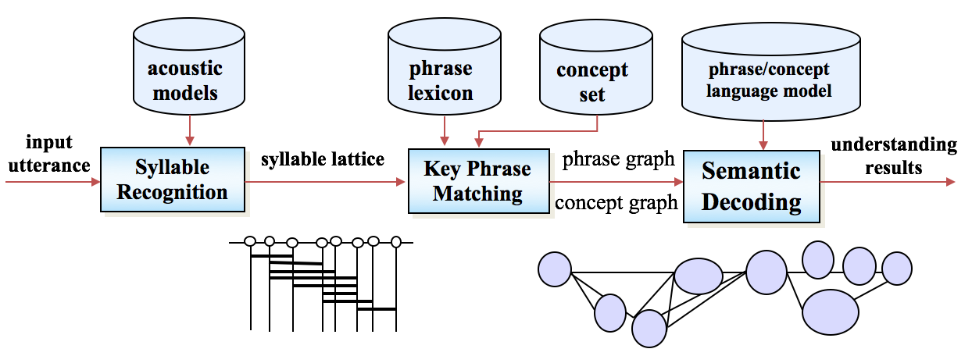
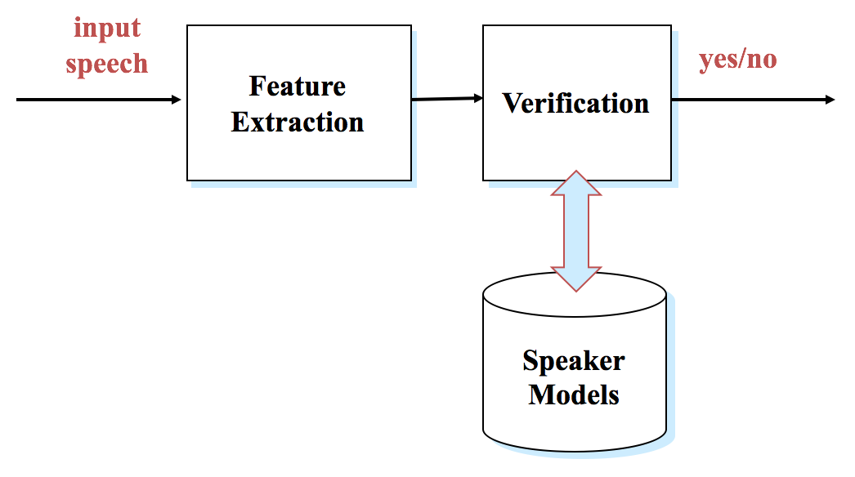
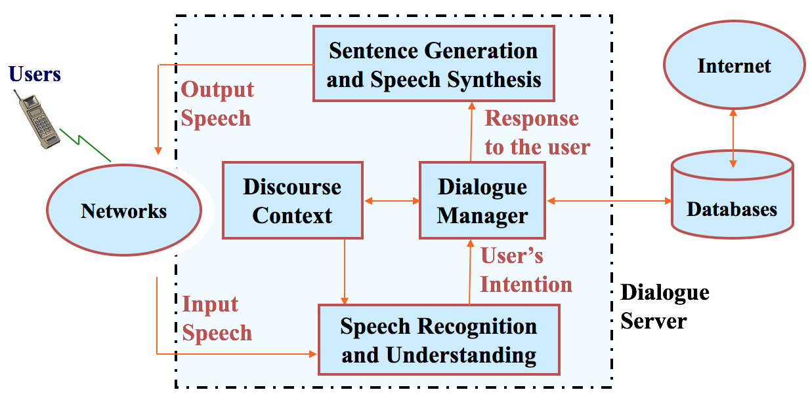
版權聲明
頁碼 | 作品 | 版權標示 | 作者 / 來源
22 |  |  | 國立臺灣大學電機工程學系李琳山 教授。 本作品採用創用CC「姓名標示-非商業性-相同方式分享3.0臺灣」許可協議。
23 |  |  | 國立臺灣大學電機工程學系李琳山 教授。 本作品採用創用CC「姓名標示-非商業性-相同方式分享3.0臺灣」許可協議。
25 |  |  | 國立臺灣大學電機工程學系李琳山 教授。 本作品採用創用CC「姓名標示-非商業性-相同方式分享3.0臺灣」許可協議。

